Slide 1
Data Analysis and Machine Learning for Beginners and Non-Programmers
Richard Johansen
10/10/2018

Slide 2
Expectations
Assumptions:
You have some basic computer and mathematical skills
You also have some general data & data visualization knowledge
You know what a scatter plot is…
You know the difference between numerical and categorical data…
Prerequisites:
Orange is already installed on your personal device
Caveat
This is simple introduction to an extremely complex and emerging field. We cannot and will cover everything
Goal
The aim of this workshop is to expose you to the Orange environment and common machine learning techniques through a few hands-on exercises

Slide 3
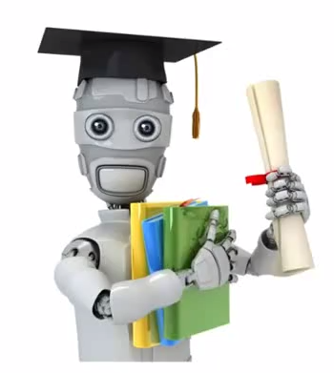
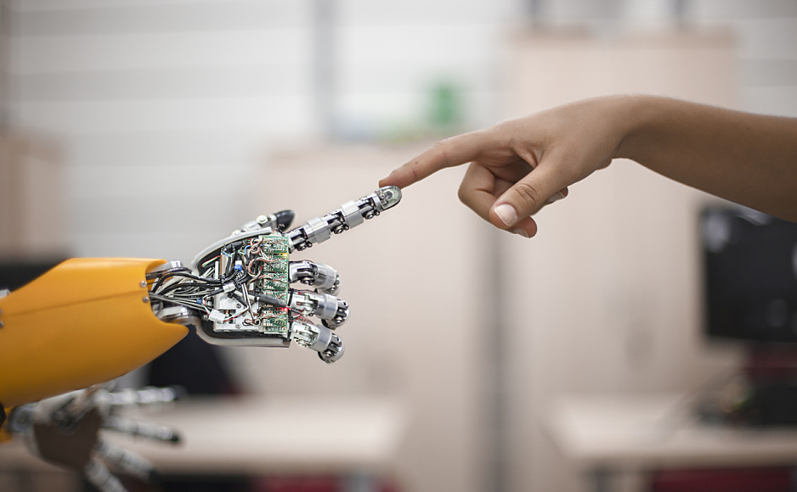
Brief Introduction
Machine learning is the application of statistical learning techniques to automatically identify patterns in data.
These techniques can be used to make highly accurate predictions.
https://static.securityintelligence.com/uploads/2017/01/improve-threat-classification-accuracy-with-supervised-machine-learning.jpg
https://datasciencelab.files.wordpress.com/2013/11/ml.png

Slide 4
Types of Machine Learning
Supervised Learning
The method “learns” from user-provided data (tabular data sets, images, etc.)
Classification: The output variable is categorical (i.e. land-use class, )
Regression: The output variable is a numerical value (i.e. plant height, body weight)
Unsupervised Learning
The method discovers and evaluates the relationship/groupings by itself.
Association: Used when you want to discover general rules about your data
People that do “X” are likely to do “Y”
Clustering: Used when you want to group data into statistically homogenous clusters
Users defines “Cluster A” has comprised of older-suburban home-owners
Users defines “Cluster B” has comprised of younger urban renters
Reinforcement Learning
The method improves results that change through repeated exposure of the environment (feedback loops of rewards/punishments)
https://towardsdatascience.com/introduction-to-machine-learning-db7c668822c4

Slide 5
The math behind the scenes
Here is the minimum level of mathematics that is needed for Machine Learning Engineers / Data Scientists.
1. Linear Algebra (Matrix Operations, Projections, Factorisation, Symmetric Matrices, Orthogonalisation)
2. Probability Theory and Statistics (Probability Rules & Axioms, Bayes’ Theorem, Random Variables, Variance and Expectation, Conditional and Joint Distributions, Standard Distributions.)
3. Calculus (Differential and Integral Calculus, Partial Derivatives)
4. Algorithms and Complex Optimisations (Binary Trees, Hashing, Heap, Stack)
https://towardsdatascience.com/introduction-to-machine-learning-db7c668822c4

Slide 6
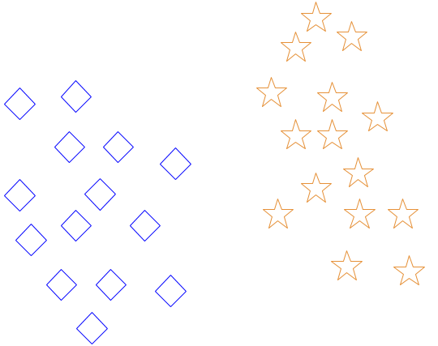
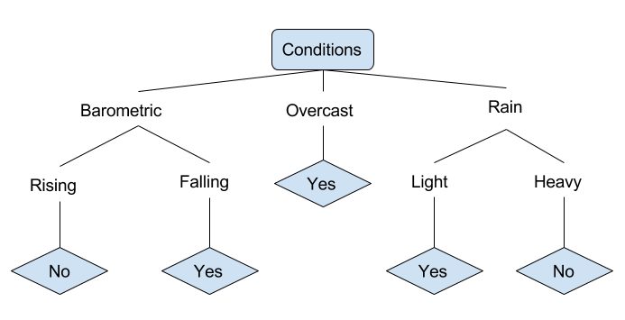
Key Terms
Correlation
The measure of association between two variables
Regression
Used to examine the relationship between one dependent and one independent variable.
k-nearest neighbor (k-NN)
Used in either classification or regression, to evaluate an observation using the # of NN.
Decision Tree Learning
Creates a flow diagram to evaluate and classify observations.
Produces a nice visual workflow for human interpretation
?
https://www.digitalocean.com/community/tutorials/an-introduction-to-machine-learning

Slide 7
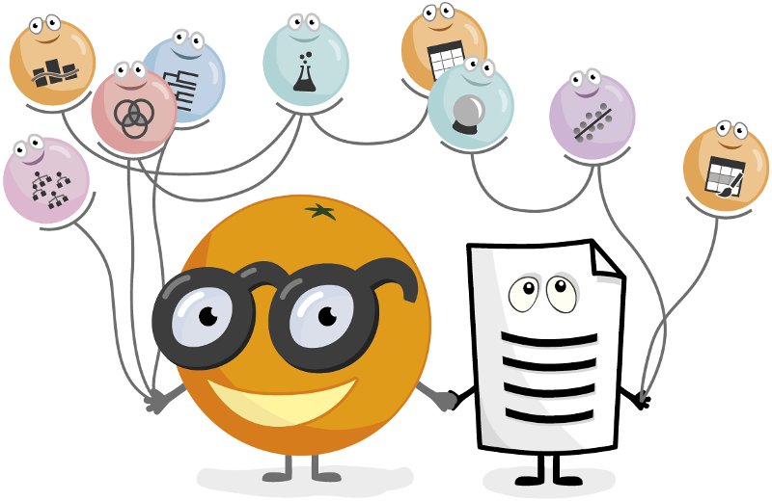
Getting Started With Orange
Orange is a free and open-source data science software
Designed with an interactive and user-friendly interface
Contains powerful data mining and visualization widgets for data analysis

Slide 8
Orange Widgets
Data management
Visualizations
Modeling
Evaluation
Clusters (supervised and unsupervised)
Data Fusion
Text Analysis
Association
Network Analysis
Bioinformatics
Teaching and Educational
https://orange.biolab.si/toolbox/

Slide 9
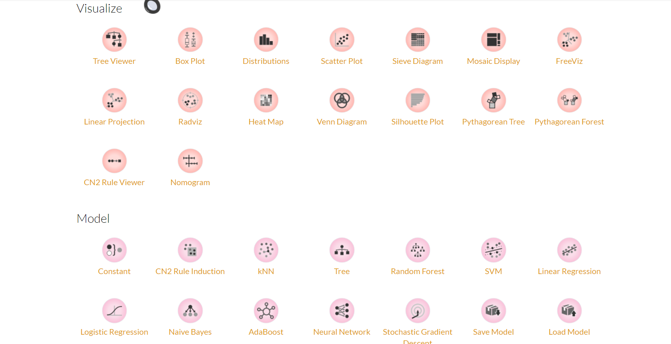
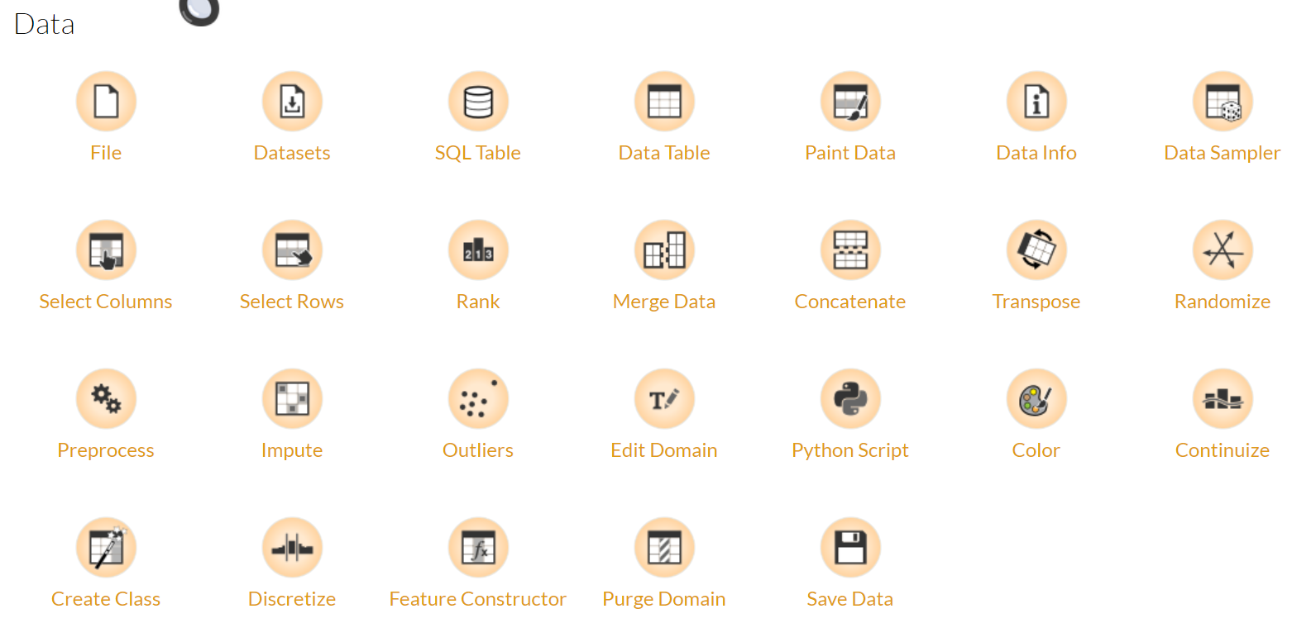

Slide 10
Want to continue learning?
Lynda.com: (Free from UC):
The Essential Elements of Predictive Analytics and Data Mining
Lots of Machine Learning for “X”, “Y”, “Z”
Library Workshops:
https://webapps2.uc.edu/ce/facdev/Workshops
UC Courses:
BANA 4080 - Data Mining and Analysis
CS 4033 - Artificial Intelligence: Principles and Applications
CS 5137/6037 - Machine Learning
GEOG 5198C/6098C - Practical Data Mining and Visualization
IS 4030 - Business Intelligence
IT 4015C - Applied Business Intelligence
And of course....Google/YouTube

Slide 11
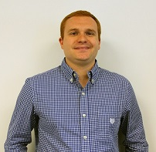

How to Contact Us:
Viz Lab Manager:
Richard Johansen, Data Visualization Specialist
GitHub: https://github.com/RAJohansen/
Twitter: @DataVizJohansen
Data & GIS Collab Manager:
Amy Koshoffer, Science Informationist
Email: AskData@uc.edu
Web: https://libraries.uc.edu/digital-scholarship/data-services.html
Visit: 240 Braunstein Hall (Geology-Math-Physics Library)

Slide 12
Questions?

